Slide 1
CMPE 321 COMPUTER ARCHITECTURE
TA: Selek Ceren Çelik
Office LocatIon: E3- 202

Slide 2
NOTES
2^8 = 256
2^10 = 1024 = 1 KB
2^20 = 1 MB
2^30 = 1 GB
1 byte = 8 bits
1 kilobyte (K / Kb) = 2^10 bytes = 1,024 bytes
1 megabyte (M / MB) = 2^20 bytes = 1,048,576 bytes
1 gigabyte (G / GB) = 2^30 bytes = 1,073,741,824 bytes
1 terabyte (T / TB) = 2^40 bytes = 1,099,511,627,776 bytes

Slide 3

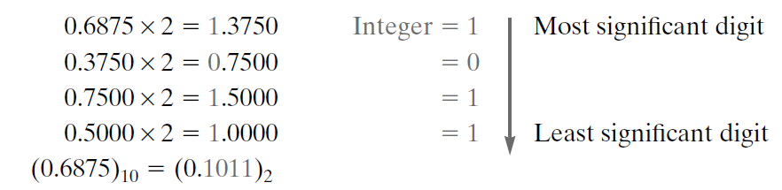
Example of Conversion

Slide 4
QUESTION 1

Slide 5
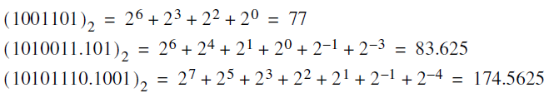
Answer 1

Slide 6
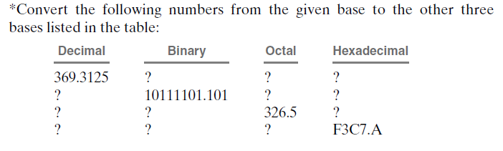
Question 2

Slide 7
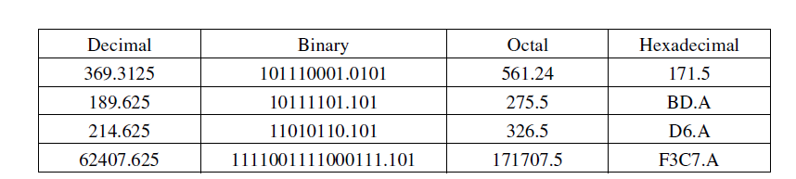
Answer 2

Slide 8
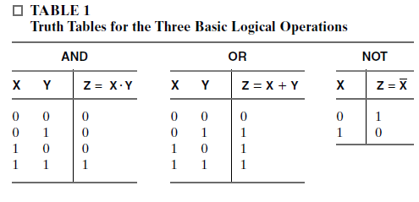
NOTES

Slide 9
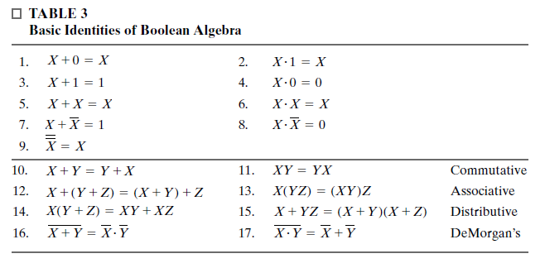
NOTES

Slide 10
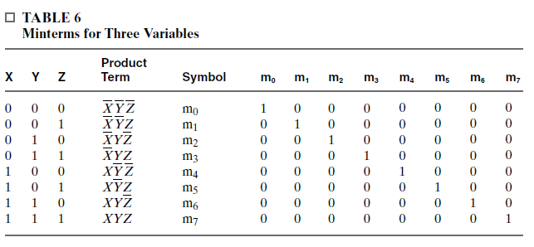
NOTES

Slide 11
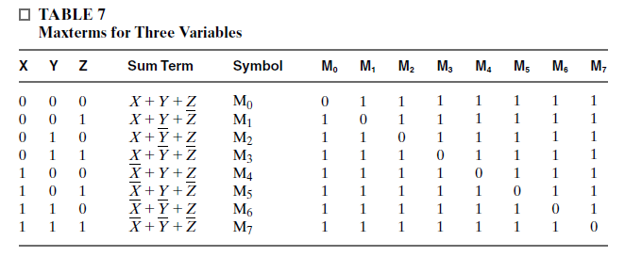
NOTES

Slide 12
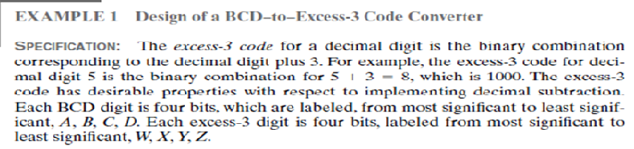

Example 1

Slide 13
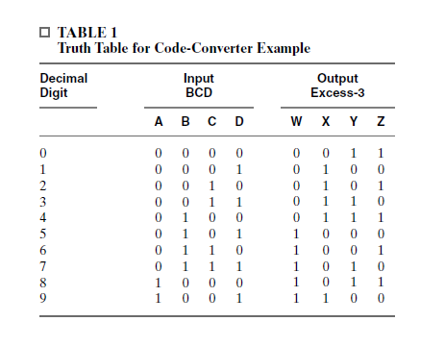
Make a Truth Table

